Slide 1



X
Kimia Farma Performance Analytics
Business Year 2020-2023
Kimia Farma - Big Data Analytics
Project Based Internship
Presented by
Muchammad Farchan F

Slide 2





Muchammad Farchan Fachrudin
Fresh Graduate of Information System Student
A fresh graduate of information systems student from Trunojoyo University, Madura. I am actively involved in many things, such as mobile and website UI/UX design, creating websites, and data analysis. I am constantly trying to improve my skills and explore new insights. Apart from that, my hobbies include swimming and cycling.
Gresik, East Java
farchanaan345@gmail.com
https://www.linkedin.com/in/muchammad-farchan-fachrudin-85230b1b9/

Slide 3

About Company
Kimia Farma was the first pharmaceutical industrial company in Indonesia which was founded by the Dutch East Indies Government in 1817. The name of this company was originally NV Chemicalien Handle Rathkamp & Co. Based on the nationalization policy of former Dutch companies in the early days of independence, in 1958, the Government of the Republic of Indonesia merged a number of pharmaceutical companies into PNF (Pharmaceutical State Company) Bhinneka Kimia Farma. Then on August 16 1971, the legal entity form of PNF was changed to a Limited Liability Company, so the company name changed to PT Kimia Farma (Persero).
Project explanation video here!
https://youtu.be/Sx5v_Zbsqls

Slide 4
Project Portfolio
This project aims to provide in-depth insight into Kimia Farma's sales performance through detailed data analysis using the data provided. The first step is to import the dataset into the BigQuery platform to ensure the required data is available. Step two, create an analysis table using BigQuery to identify sales patterns, consumer interests, and sales distribution patterns. And the third, create a dashboard visualization of the data pattern. The results of the analysis provide valuable insights into Kimia Farma's sales performance, including the factors that influence it.
Project explanation video here!
https://youtu.be/Sx5v_Zbsqls

Slide 5
The Challenges
Challenge #1
Challenge #2
Challenge #3
Importing Dataset to BigQuery
Create Analytics Tabel in BigQuery
Create Performance Dashboard in Google Looker
Project explanation video here!
https://youtu.be/Sx5v_Zbsqls

Slide 6
Importing Dataset to BigQuery
Prepare the data set to be used
Create a new project in Google Cloud Project (GCP) with the name Rakamin_KF_Analytics
Open BigQuery console
Create a Dataset: ‘Kimia_farma’
Run SQL Query for creating a new table
Verify import dataset
Import the dataset into BigQuery
kf_final_transaction.csv
kf_inventory.csv
kf_kantor_cabang.csv
kf_product.csv
Project explanation video here!
https://youtu.be/Sx5v_Zbsqls

Slide 7
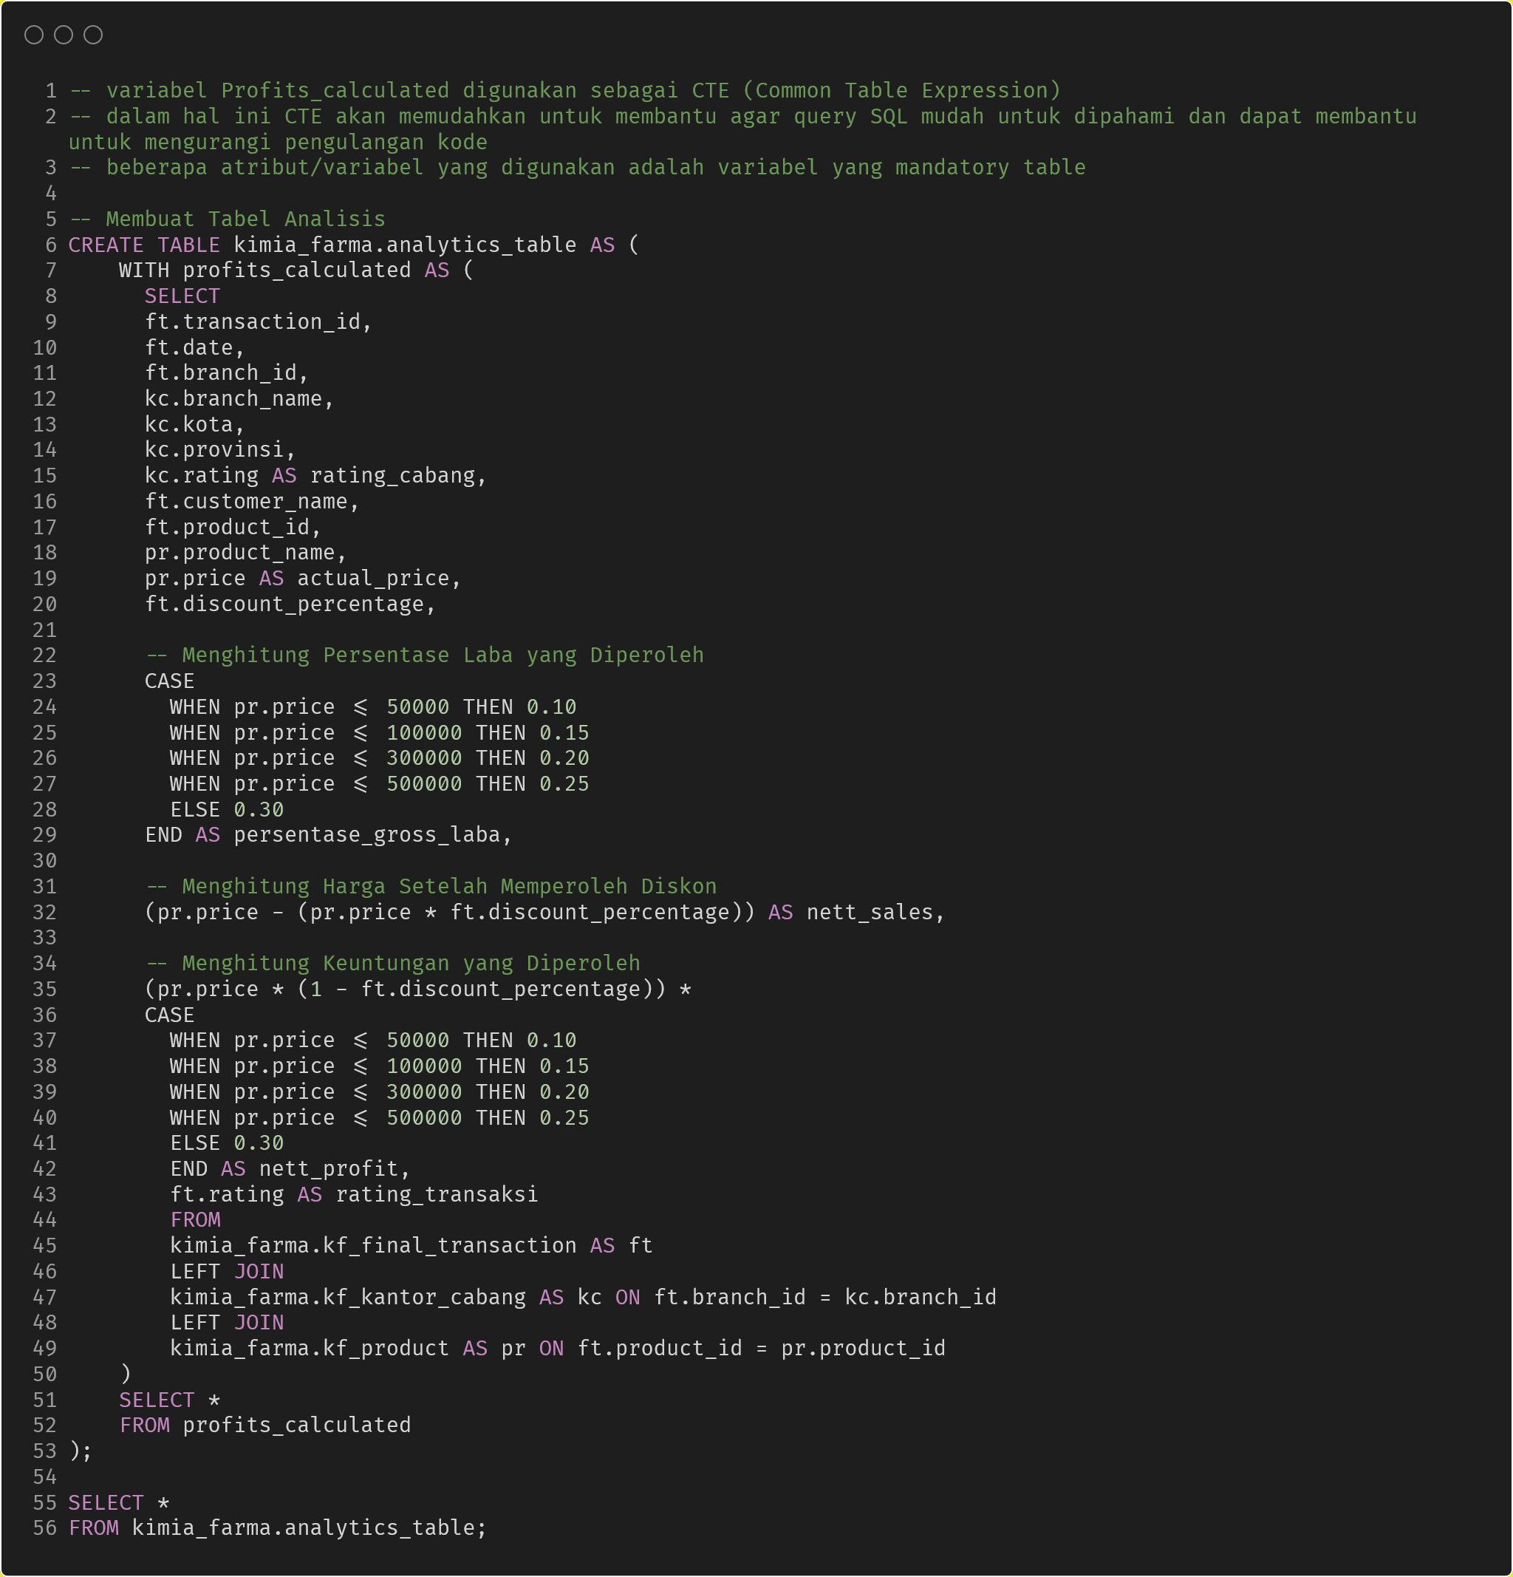
BigQuery Sintax
This SQL syntax serves to create a new table named analytics_table in kimia_farma database. The new table is populated with data selected from existing tables such as kf_final_transaction, kf_inventory, kf_kantor_cabang, and kf_product.
variables Profits_calculated be used as CTE (Common Table Expression) in this case CTE will make it easier to help make SQL queries easier to understand and can help to reduce code repetition
Project explanation video here!
https://youtu.be/Sx5v_Zbsqls

Slide 8
BigQuery Sintax
This SELECT statement fetches data from the specified tables (kf_final_transaction, kf_kantor_cabang, and kf_product).
Project explanation video here!
https://youtu.be/Sx5v_Zbsqls

Slide 9
BigQuery Sintax
The sql query below serves to calculate the percentage of profit earned (converted into the presentase_gross_laba attribute) and calculate the price after obtaining a discount (converted into the nett_sales attribute)
Project explanation video here!
https://youtu.be/Sx5v_Zbsqls

Slide 10
BigQuery Sintax
The sql query below serves to calculate the profit obtained (converted into nett_profit attribute) and the addition of the rating attribute which is converted into rating_transaksi
Project explanation video here!
https://youtu.be/Sx5v_Zbsqls

Slide 11
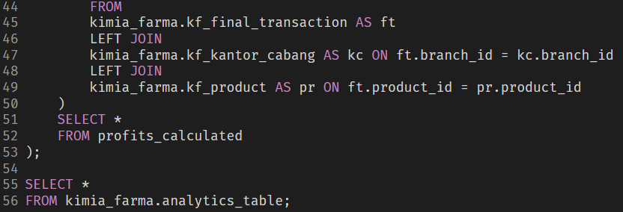
BigQuery Sintax
This section specifies the tables to join (kf_final_transaction, kf_kantor_cabang, and kf_product) and the conditions for joining them. It joins kf_final_transaction with kf_kantor_cabang in branch_id and kf_final_transaction with kf_product in product_id. Then retrieve all columns from profit_calculated and retrieve all table columns from analytics_table
Project explanation video here!
https://youtu.be/Sx5v_Zbsqls

Slide 12
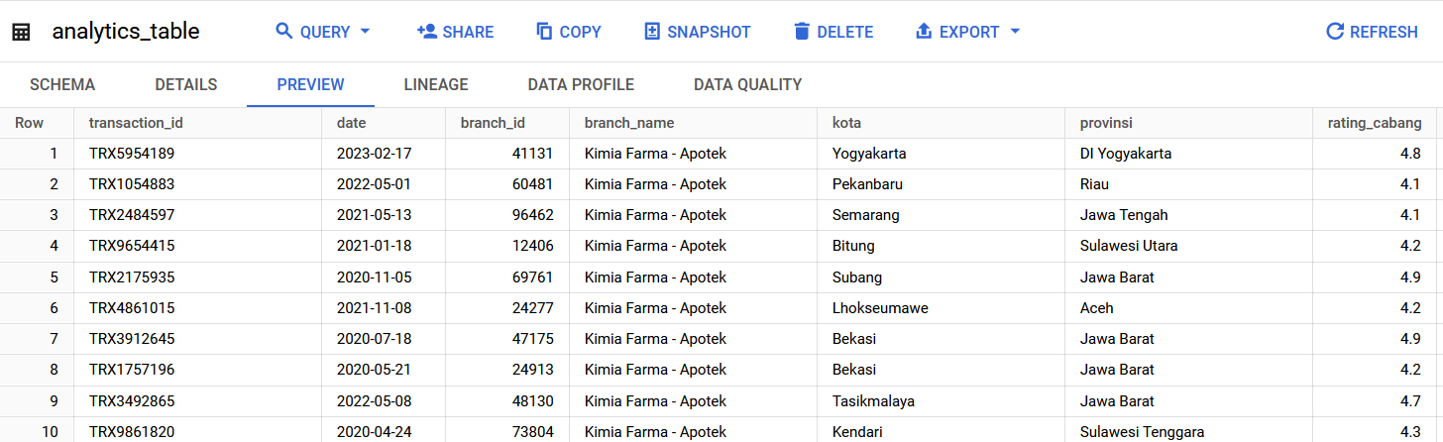
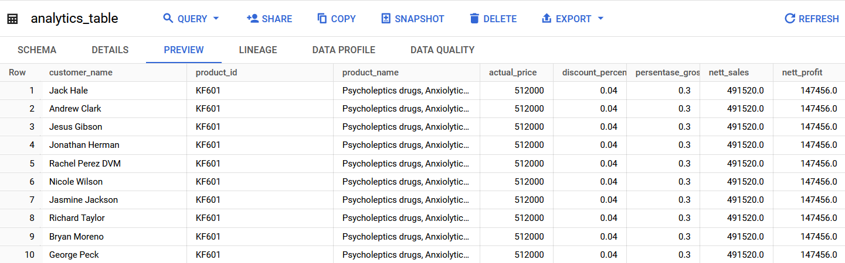
Tabel Analisa
New Table Preview

Slide 13
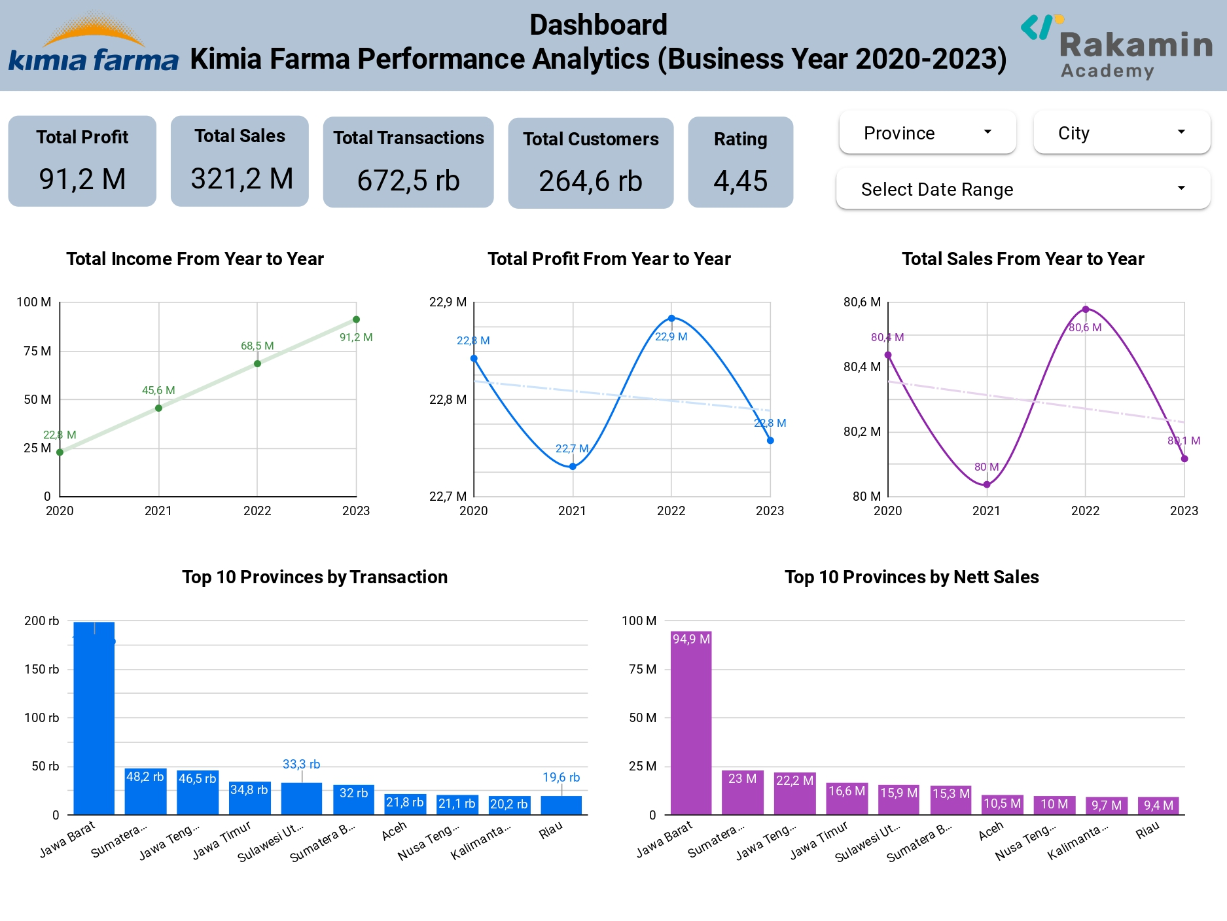
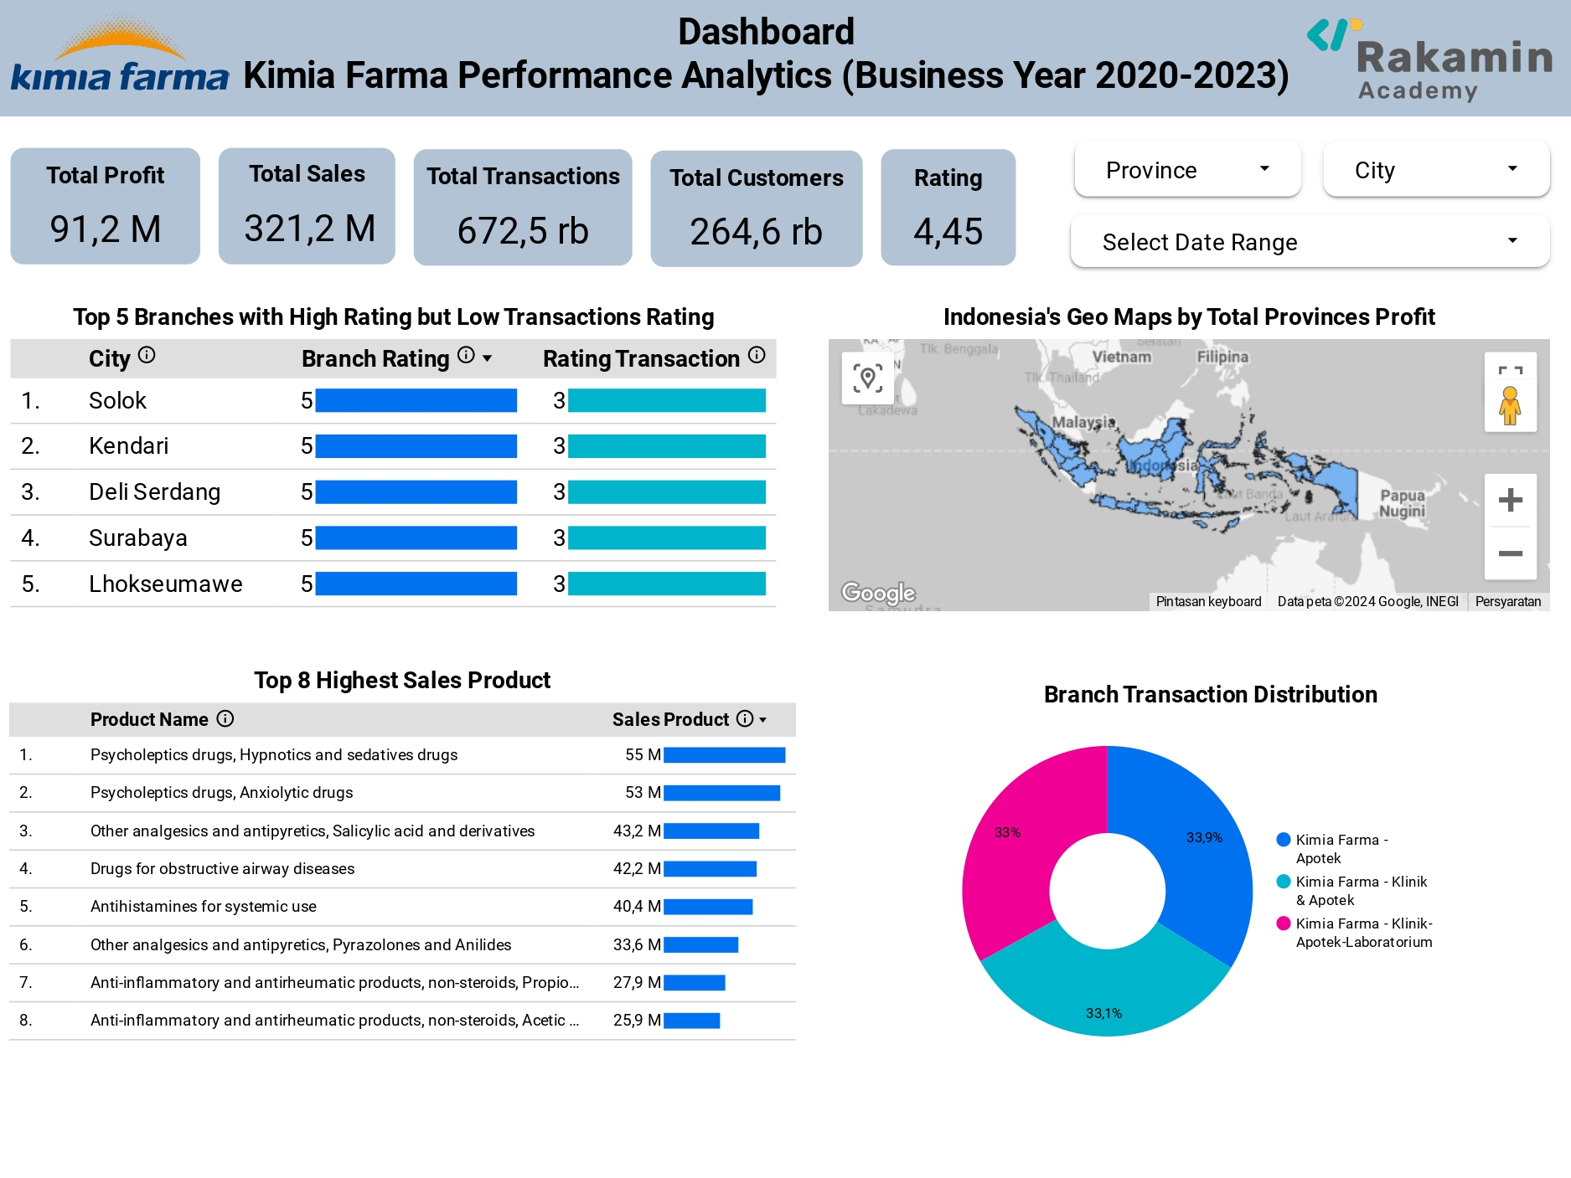
Dashboard Performance Analytics
Link: https://lookerstudio.google.com/reporting/82957fd3-208f-4703-8c5f-e0fc70d97c95
Project explanation video here!
https://youtu.be/Sx5v_Zbsqls

Slide 14
Thank You
X

